Slide 1


Credit Card Fraud
Rachel Nelson
DSC530-T303 Data Exploration and Analysis (2211-1)

Slide 2

statistical questions
What are factors that correlate to fraud?
Can you use those factors to create predictions on which credit card transactions are fraudulent?
Notes:
outlining your statistical question/hypothesis

Slide 3
Data Set
The datasets contains transactions made by credit cards in September 2013 by european cardholders.
This dataset presents transactions that occurred in two days, where we have 492 frauds out of 284,807 transactions. The dataset is highly unbalanced, the positive class (frauds) account for 0.172% of all transactions.
Notes:
A minimum of 5 variables in your dataset used during your analysis (for help with selecting, the author made his selection on page 6 of your book).
Consider what you think could have an impact on your question – remember this is never perfect, so don’t be worried if you miss one (Chapter 1).

Slide 4
Variables
The data set contains 31 numerical input variables
28 variables are results of a PCA transformation.
Other variables are 'Time' and 'Amount'.
'Time' contains the seconds elapsed between each transaction and the first transaction in the dataset.
'Amount' is the transaction Amount, this feature can be used for example-dependent cost-sensitive learning.
Feature 'Class' is the response variable and it takes value 1 in case of fraud and 0 otherwise.
Limiting variables to :V4, V11, Class, Time and Amount
Notes:
Describe what the 5 variables mean in the dataset (Chapter 1).

Slide 5
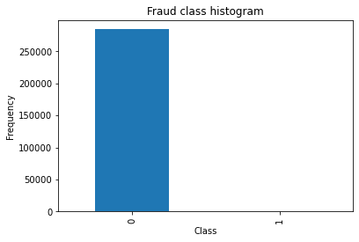
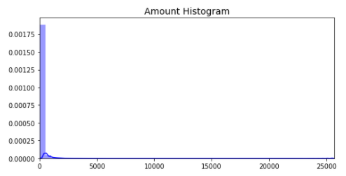
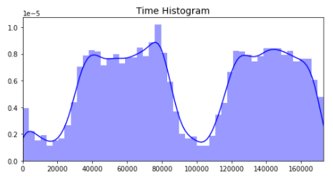
Variable Histograms
Class
Amount
Time
There are only .17% transactions that are fraud. To fix I will be taking a random sample of non-fraud cases to balance out the data.
Amount is skewed to the right.
Looks like there may be two or three different distributions with time. No action taken
Notes:
o Include a histogram of each of the 5 variables – in your summary and analysis, identify any outliers and explain the reasoning for them being outliers and how you believe they should be handled (Chapter 2).

Slide 6
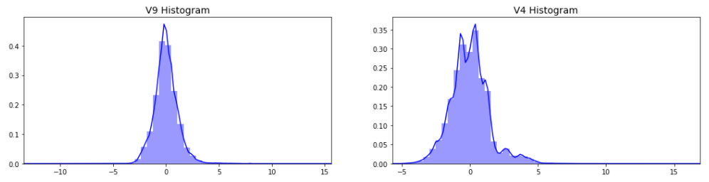
Variable Histograms
V4
V9
V4 is skewed to the right
V9 looks like it has a normal distribution
Notes:
o Include a histogram of each of the 5 variables – in your summary and analysis, identify any outliers and explain the reasoning for them being outliers and how you believe they should be handled (Chapter 2).

Slide 7
Descriptive Characteristics
 | Mean | Mode | Variance (Spread) | Skewness (Tails)
Class | 0.00 | 0.00 | 0.00 | 23.99
Amount | 88.35 | 1 | 62560.07 | 16.98
Time | 94813.86 | 163152 | 2255124006.20 | -0.036
V4 | 0.00 | -0.84 | 2.00 | 0.68
V9 | 0.00 | 0.17 | 1.21 | 0.55
Notes:
Include the other descriptive characteristics about the variables: Mean, Mode, Spread, and Tails (Chapter 2).

Slide 8
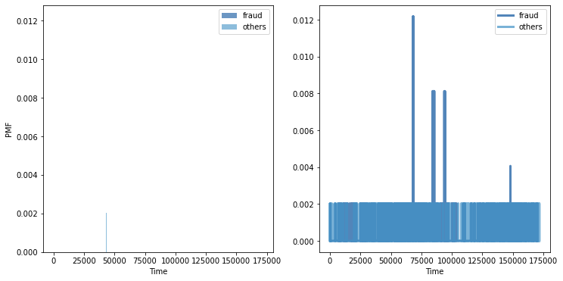
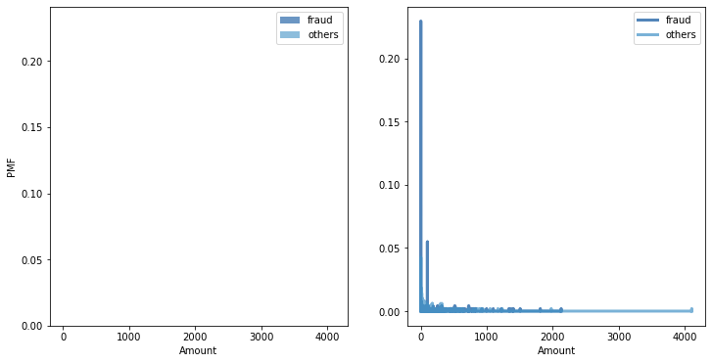
PMF: Fraud and Others
Time
Amount
Notes:
Using pg. 29 of your text as an example, compare two scenarios in your data using a PMF. Reminder, this isn’t comparing two variables against each other – it is the same variable, but a different scenario. Almost like a filter. The example in the book is first babies compared to all other babies, it is still the same variable, but breaking the data out based on criteria we are exploring (Chapter 3).

Slide 9
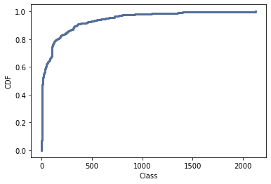
CDF
Because the CDF is not a straight line, the distribution is not uniform.
Notes:
Create 1 CDF with one of your variables, using page 41-44 as your guide, what does this tell you about your variable and how does it address the question you are trying to answer (Chapter 4).

Slide 10
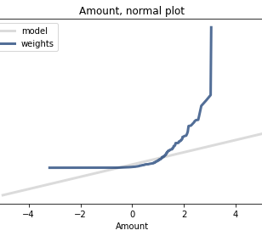
Analytical Distribution
Normal Probability Plot
Notes:
Plot 1 analytical distribution and provide your analysis on how it applies to the dataset you have chosen (Chapter 5)

Slide 11
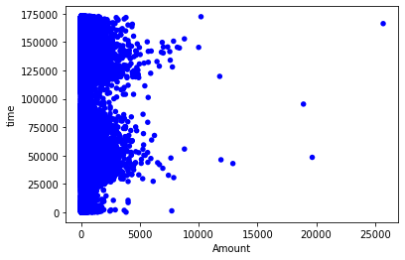
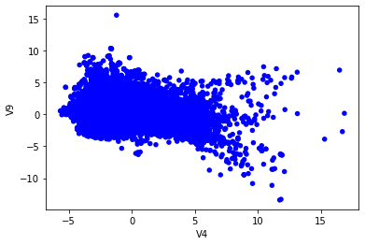
Scatter Plots
Time vs Amount
V9 vs V4
Notes:
Create two scatter plots comparing two variables and provide your analysis on correlation and causation. Remember, covariance, Pearson’s correlation, and NonLinear Relationships should also be considered during your analysis (Chapter 7).

Slide 12
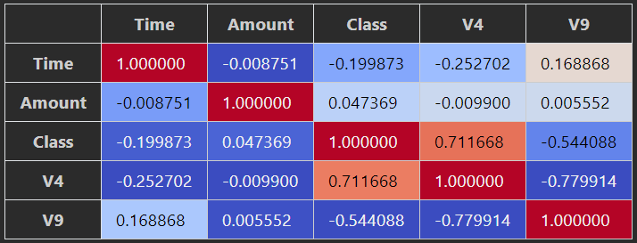
Hypothesis Testing - Correlation
Notes:
Conduct a test on your hypothesis using one of the methods covered in Chapter 9.

Slide 13
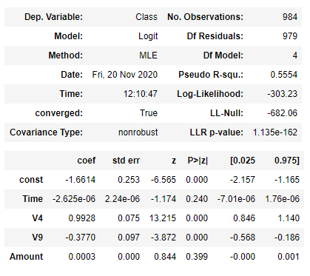
Regression Analysis (Logistic Regression)
Dependent Variable: Class
Explanatory Variables: Time, Amount, V4 + V9
The p-values for Time and Amount were not statistically significant and would probably be best to remove as a explanatory variable. I would keep V4 + V9 since each has a p-value < 0.05
Notes:
For this project, conduct a regression analysis on either one dependent and one explanatory variable, or multiple explanatory variables (Chapter 10 & 11).

Slide 14
Acknowledgements
The dataset has been collected and analyzed during a research collaboration of Worldline and the Machine Learning Group (http://mlg.ulb.ac.be) of ULB (Université Libre de Bruxelles) on big data mining and fraud detection. More details on current and past projects on related topics are available on https://www.researchgate.net/project/Fraud-detection-5 and the page of the DefeatFraud project
References:
Andrea Dal Pozzolo, Olivier Caelen, Reid A. Johnson and Gianluca Bontempi. Calibrating Probability with Undersampling for Unbalanced Classification. In Symposium on Computational Intelligence and Data Mining (CIDM), IEEE, 2015
Dal Pozzolo, Andrea; Caelen, Olivier; Le Borgne, Yann-Ael; Waterschoot, Serge; Bontempi, Gianluca. Learned lessons in credit card fraud detection from a practitioner perspective, Expert systems with applications,41,10,4915-4928,2014, Pergamon
Dal Pozzolo, Andrea; Boracchi, Giacomo; Caelen, Olivier; Alippi, Cesare; Bontempi, Gianluca. Credit card fraud detection: a realistic modeling and a novel learning strategy, IEEE transactions on neural networks and learning systems,29,8,3784-3797,2018,IEEE
Dal Pozzolo, Andrea Adaptive Machine learning for credit card fraud detection ULB MLG PhD thesis (supervised by G. Bontempi)
Carcillo, Fabrizio; Dal Pozzolo, Andrea; Le Borgne, Yann-Aël; Caelen, Olivier; Mazzer, Yannis; Bontempi, Gianluca. Scarff: a scalable framework for streaming credit card fraud detection with Spark, Information fusion,41, 182-194,2018,Elsevier
Carcillo, Fabrizio; Le Borgne, Yann-Aël; Caelen, Olivier; Bontempi, Gianluca. Streaming active learning strategies for real-life credit card fraud detection: assessment and visualization, International Journal of Data Science and Analytics, 5,4,285-300,2018,Springer International Publishing
Bertrand Lebichot, Yann-Aël Le Borgne, Liyun He, Frederic Oblé, Gianluca Bontempi Deep-Learning Domain Adaptation Techniques for Credit Cards Fraud Detection, INNSBDDL 2019: Recent Advances in Big Data and Deep Learning, pp 78-88, 2019
Fabrizio Carcillo, Yann-Aël Le Borgne, Olivier Caelen, Frederic Oblé, Gianluca Bontempi Combining Unsupervised and Supervised Learning in Credit Card Fraud Detection Information Sciences, 2019
Martinez, Janio (2019). Credit Fraud Detector. Retreived from: https://www.kaggle.com/janiobachmann/credit-fraud-dealing-with-imbalanced-datasets

